Slide 1
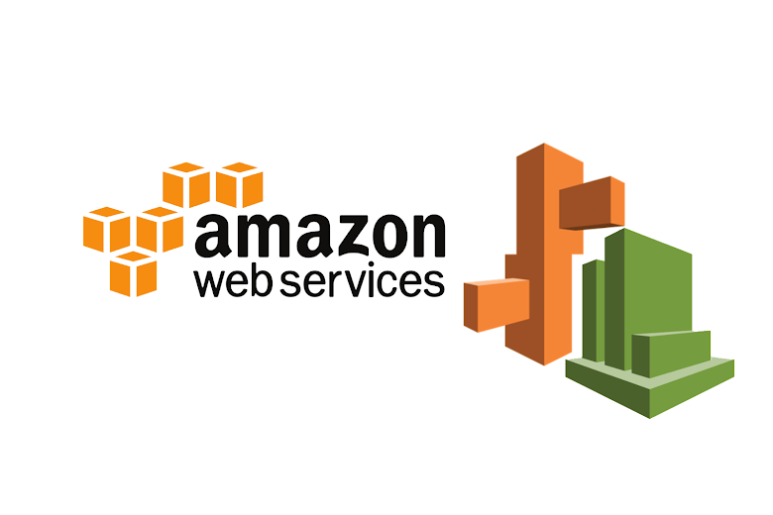

Slide 2
AWS LAMBDA
AWS Lambda is a serverless computing service provided by Amazon Web Services (AWS). It allows you to run code without provisioning or managing servers. Here are some key features and concepts:
Event-Driven: AWS Lambda runs your code in response to events, such as changes to data in an Amazon S3 bucket, updates to a DynamoDB table, or HTTP requests via Amazon API Gateway.
Automatic Scaling: Lambda automatically scales your applications by running code in response to each trigger. Your code runs in parallel and processes each trigger individually, scaling precisely with the size of the workload.
Pay-As-You-Go: You only pay for the compute time you consume - there is no charge when your code is not running.
Supported Languages: AWS Lambda natively supports several programming languages, including Node.js, Python, Ruby, Java, Go, and .NET Core. You can also bring your own runtime.
Execution Environment: The Lambda function runs in an isolated execution environment. Each function runs in its own environment with its own resources and can scale independently.
Integration with Other AWS Services: Lambda can be integrated with many AWS services like S3, DynamoDB, Kinesis, SNS, CloudWatch, and more, making it a powerful component for building serverless architectures.
Function Configuration: You can configure various aspects of your Lambda function, such as memory allocation, timeout period, environment variables, and IAM role permissions.
Cold Starts: The first request to a Lambda function can take longer to process if the function has been inactive, which is known as a cold start. Subsequent requests are typically faster.
Here’s a basic example of how you might create and deploy a Lambda function using the AWS Management Console:

Slide 3
API GATEWAY
Amazon API Gateway is a fully managed service that makes it easy for developers to create, publish, maintain, monitor, and secure APIs at any scale. It acts as a “front door” for applications to access data, business logic, or functionality from your backend services, such as applications running on Amazon EC2, code running on AWS Lambda, or any web application. Here are the main features and concepts:
Key Features
Creating APIs:
You can create RESTful APIs and WebSocket APIs.
API Gateway can act as a proxy to your backend or transform requests and responses.
Security:
You can enable authentication and authorization using AWS Identity and Access Management (IAM) roles, Amazon Cognito, or custom authorizers.
API Gateway supports throttling and quota limits to protect your backend services from being overwhelmed by too many requests.
Integration with Other AWS Services:
It integrates seamlessly with AWS Lambda to create serverless backends.
It can directly access other AWS services like DynamoDB, S3, and SNS.
Deployment and Versioning:
You can deploy your API to different stages (e.g., development, staging, production) and manage multiple versions.
Stage variables allow you to configure different settings for each stage.
Monitoring and Logging:
API Gateway integrates with Amazon CloudWatch to provide detailed monitoring and logging.
You can enable CloudWatch Logs to capture detailed API request and response data for debugging and auditing purposes.

Slide 4
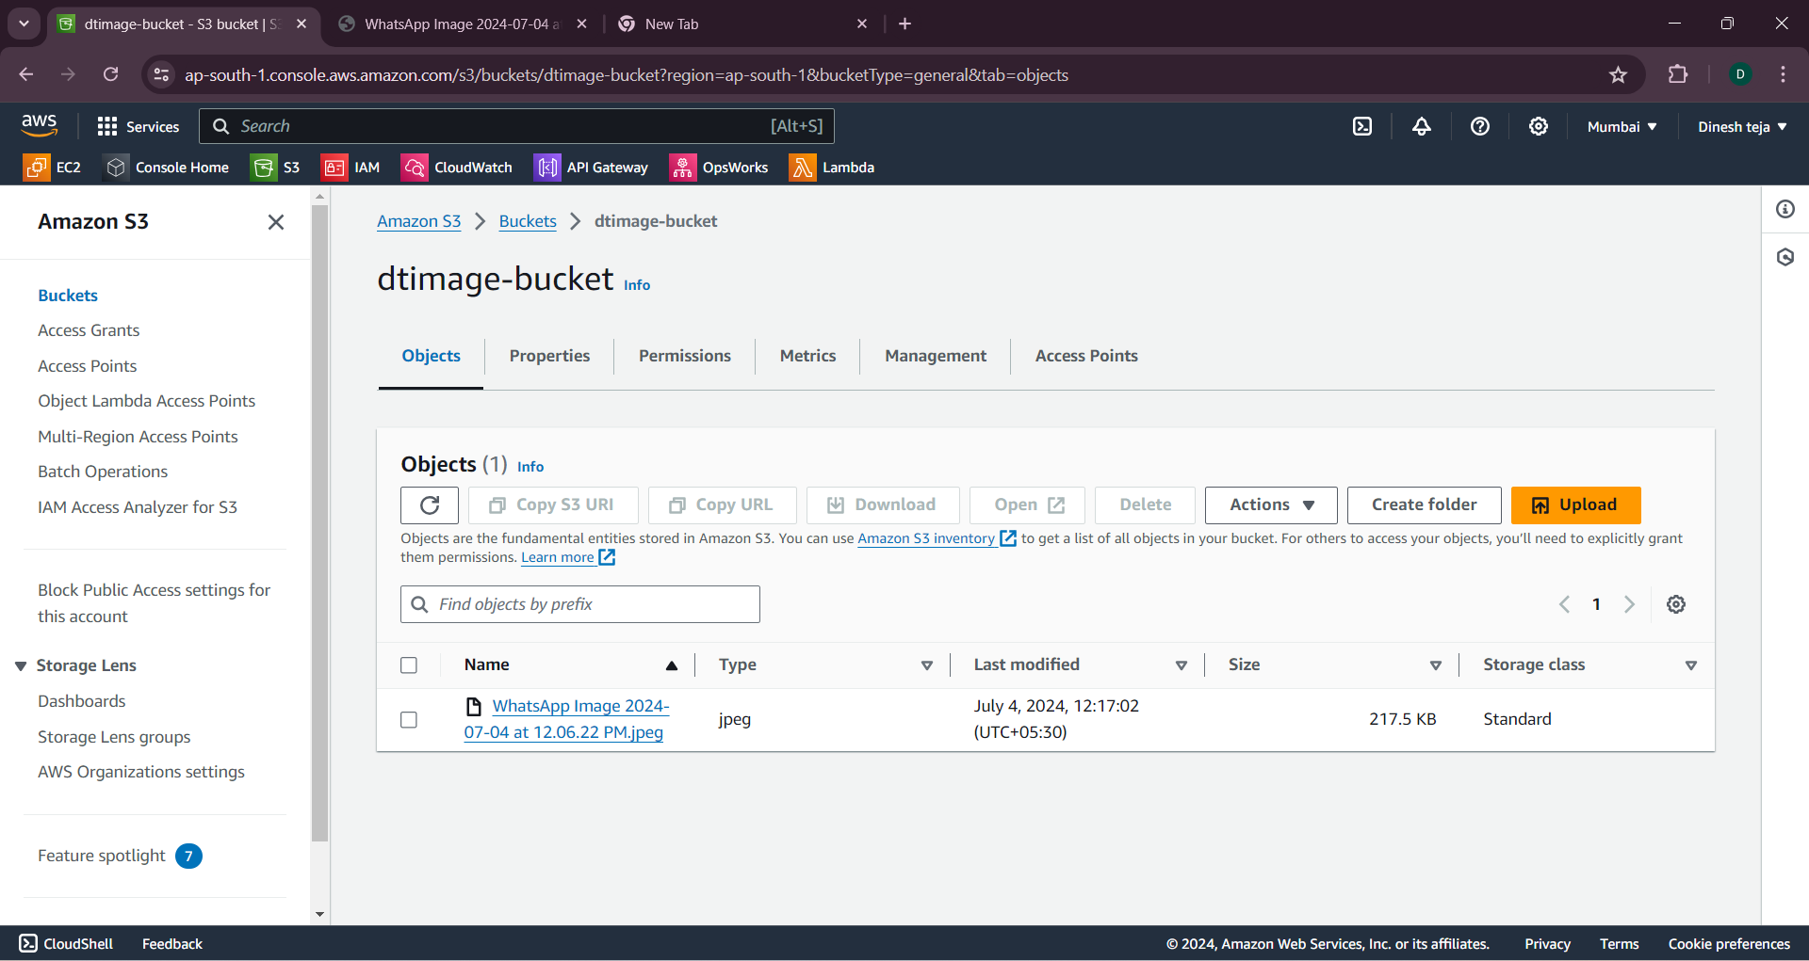
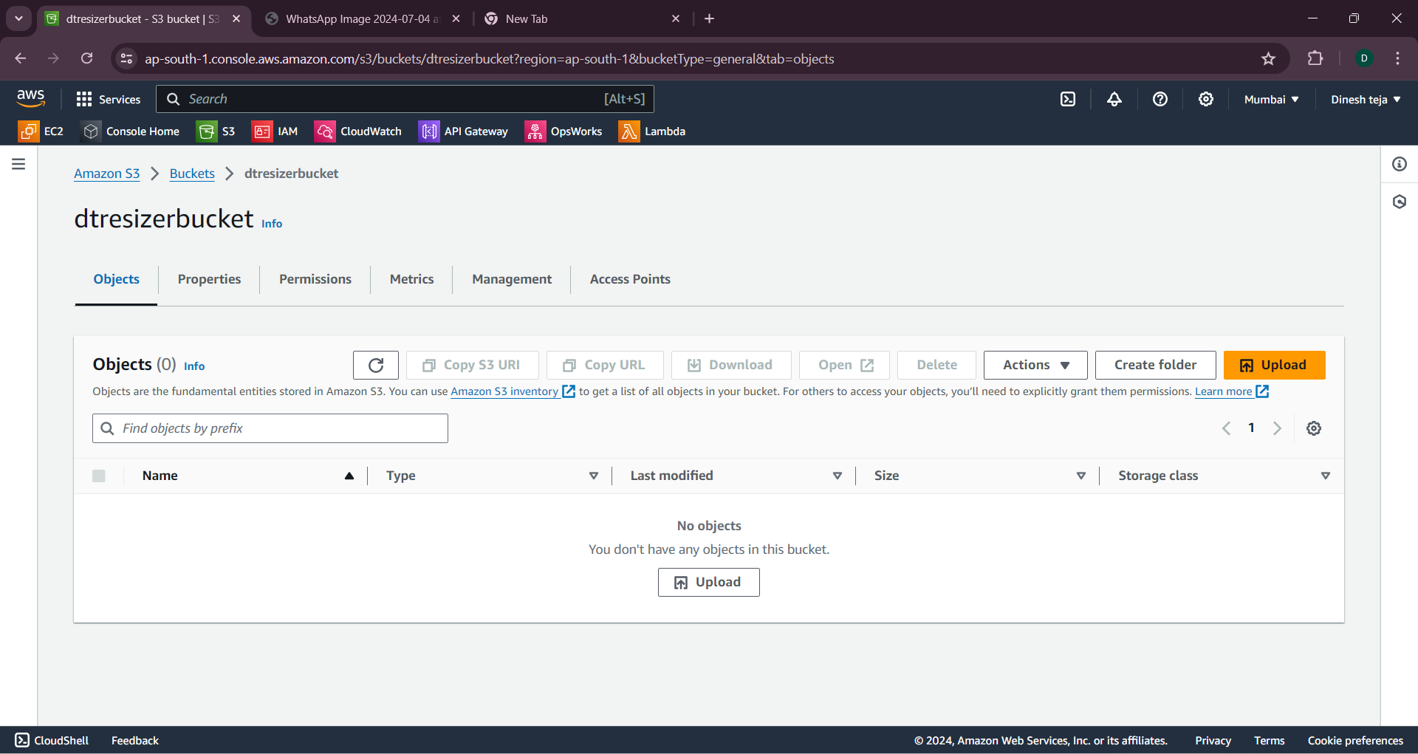
Server-less Application Create a server-less application using AWS LAMBDA and API GATEWAY Image resizing using AWS LAMBDA AND INVOKING BY API GATEWAY
Open AWS site and login to your AWS account
Open s3 bucket and create two s3 bucket , one bucket is for uploading our image in terms of .jpeg and upload in first bucket and second is used for storing resized image
Bucket for storing image
Bucket for storing resized image

Slide 5
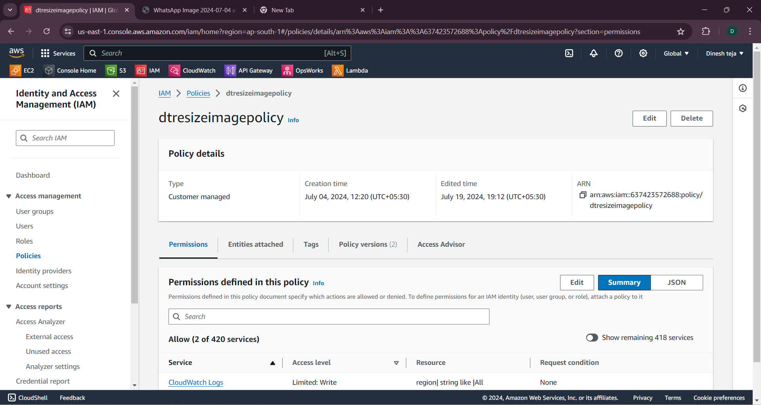
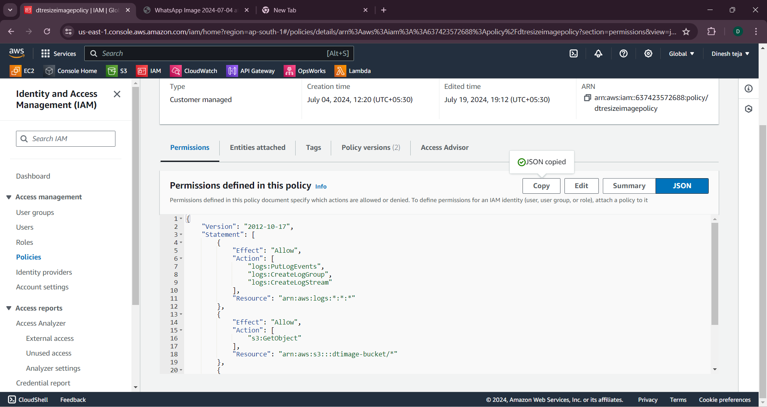
1.Create an IAM ROLE and attach the created policy to the policy 2.To create a policy open IAM policies and select the LAMBDA service and next 3.Add the json code mentioned in the fig.1 and change the bucket names in json code and click next and give the policy name

Slide 6
{
"Version": "2012-10-17",
"Statement": [
{ "Effect": "Allow",
"Action": [
"logs:PutLogEvents",
"logs:CreateLogGroup",
"logs:CreateLogStream"
],
"Resource": "arn:aws:logs:::*“
},
{
"Effect": "Allow",
"Action": [
"s3:GetObject"
],
"Resource": "arn:aws:s3:::dtimage-bucket/*"
},
{
"Effect": "Allow",
"Action": [ "s3:PutObject" ], "Resource": "arn:aws:s3:::dtresizerbucket/*“
}
]

Slide 7
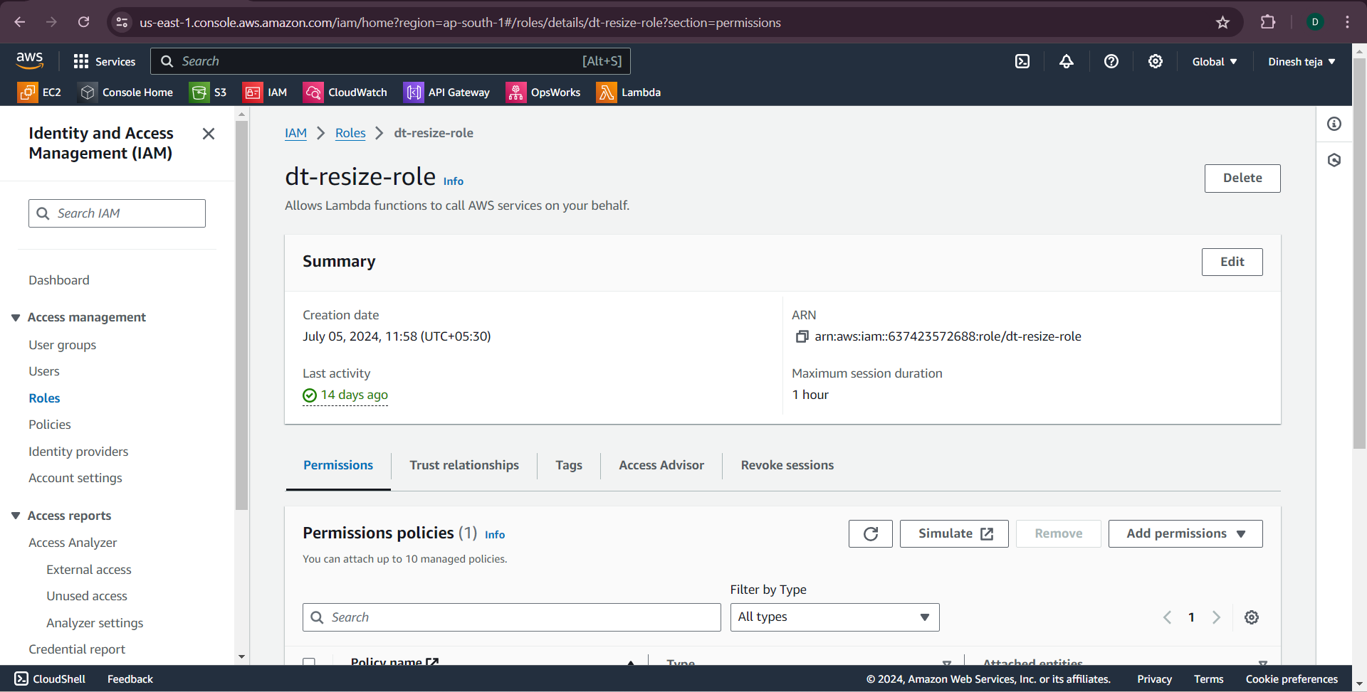
Create a role in the IAM ROLE select AWS service and mention AWS LAMBDA as a use case or service name, click the next button and select the policy which we created recently.
Add the AWS S3 BUCKET policy and AWS LAMBDA permission and select both the policies and click next and name the role and our IAM ROLE is created .

Slide 8
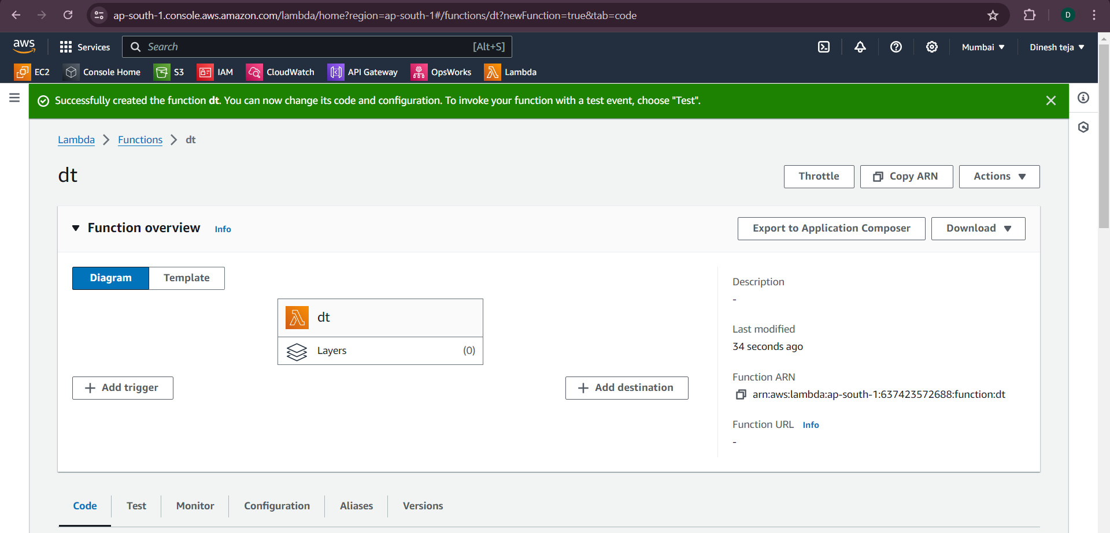
AWS LAMBDA
Open AWS LAMBDA and create a function
Name the function and choose the language as python 3.1.2 as we’re using python for our resizing image and attach the role which created recently named dt-rezise-role and click the next button

Slide 9
Upload the .zipfile which consists of the python3.1.2 code and test the code here is the python code which is required for the AWS LAMBDA
here is the zip file which consists of the source codes and upload it in the lambda function
Run the code and change the environment configuration by changing the environment name and replacing it as the resizer bucket name
After changing the configuration test the code by naming template option as s3put
Make changes in the code by naming the bucket names in the code at the names of bucket and copy the image link and paste it in the code then run the code then open the resizer bucket and our image will be resized by clicking the link in the resizer bucket
Invoke it using api gateway go to the AWS MANAGEMENT CONSOLE and open API gateway service click on create API,choose the API type ( eg,rest api.) configure the settings and create API and also configure a resource and method in API GATEWAY
In the API GATEWAY console ,create a new resource under the created API
Create a GET AND POST in the resource
Select the LAMBDA FUNCTION which we created recently and enter the name of LAMBDA FUNCTION and save it
Then deploy the API ,click on action and select deploy API ,create a new exsisting API or create API
Deploy and Invoke the api

Slide 10
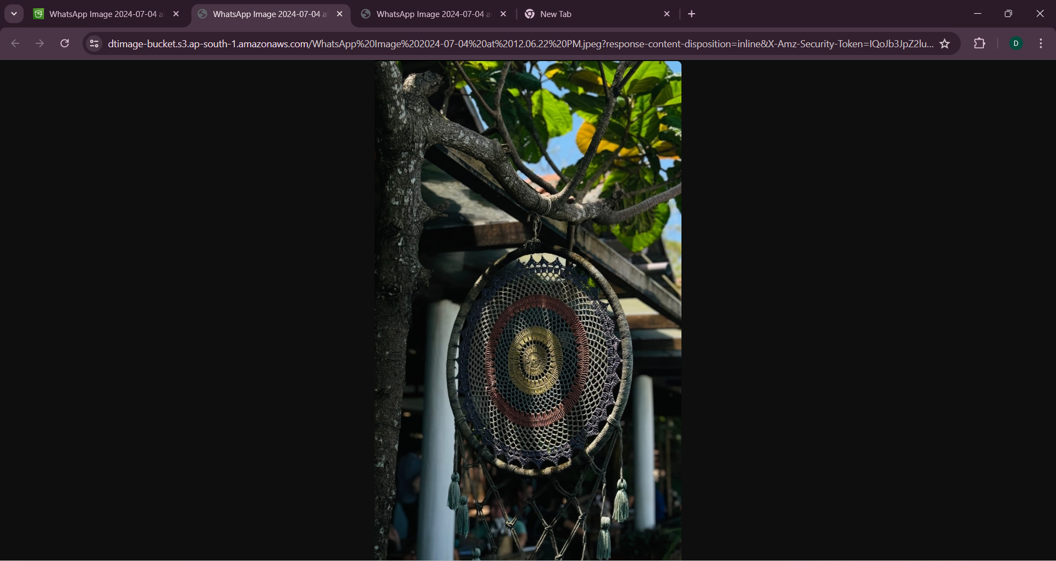

Resized image

